Slide 1

WINE TESTING
Predicting Sales According to Wine Points
Ana Pacella
Final Project CIS 541

Slide 2

Presentation Overview
TOPICS TO COVER
Purpose of study
Benefits
Dataset
Analysis test
Conclusions

Slide 3


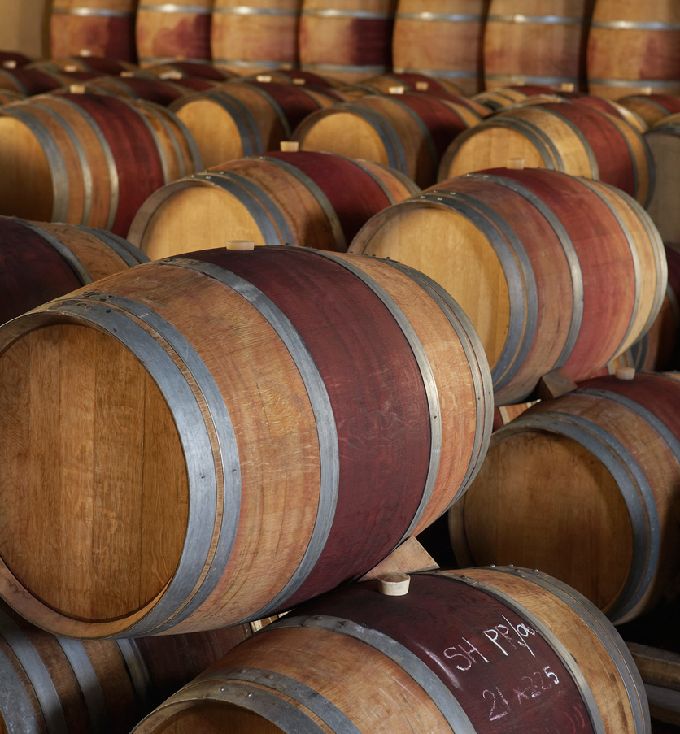

Purpose of Study
TO BETTER KNOW PRODUCT
TO ESTIMATE PRICES
CHARDONNAY VS. PINOT NOIR
Estimate prices based on points given to each wine.
To understand what types of wine are getting more points.
What are the differences on our best sellers?

Slide 4

Dataset
- More than 100k rows reviewed.
- Points, prices, wine type, wine name, country, region, vineyard.
- Used variety, points and prices as variables.
- Then focused on specific wine types.
WINE TASTING

Slide 5

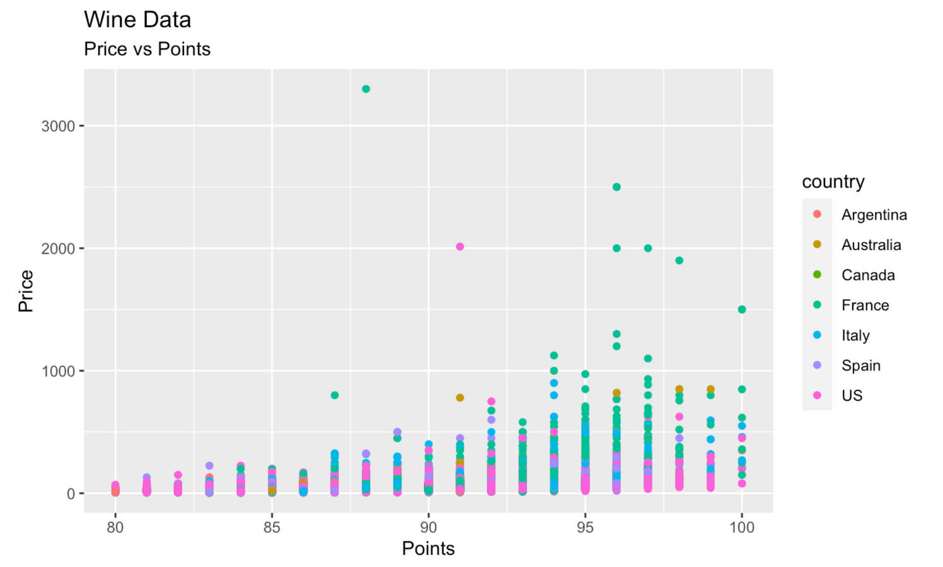

Slide 6

Chardonnay Vs. Pinot Noir
There is significant statistical difference between the average price of Pinot Noir and Chardonnay wines.

Slide 7

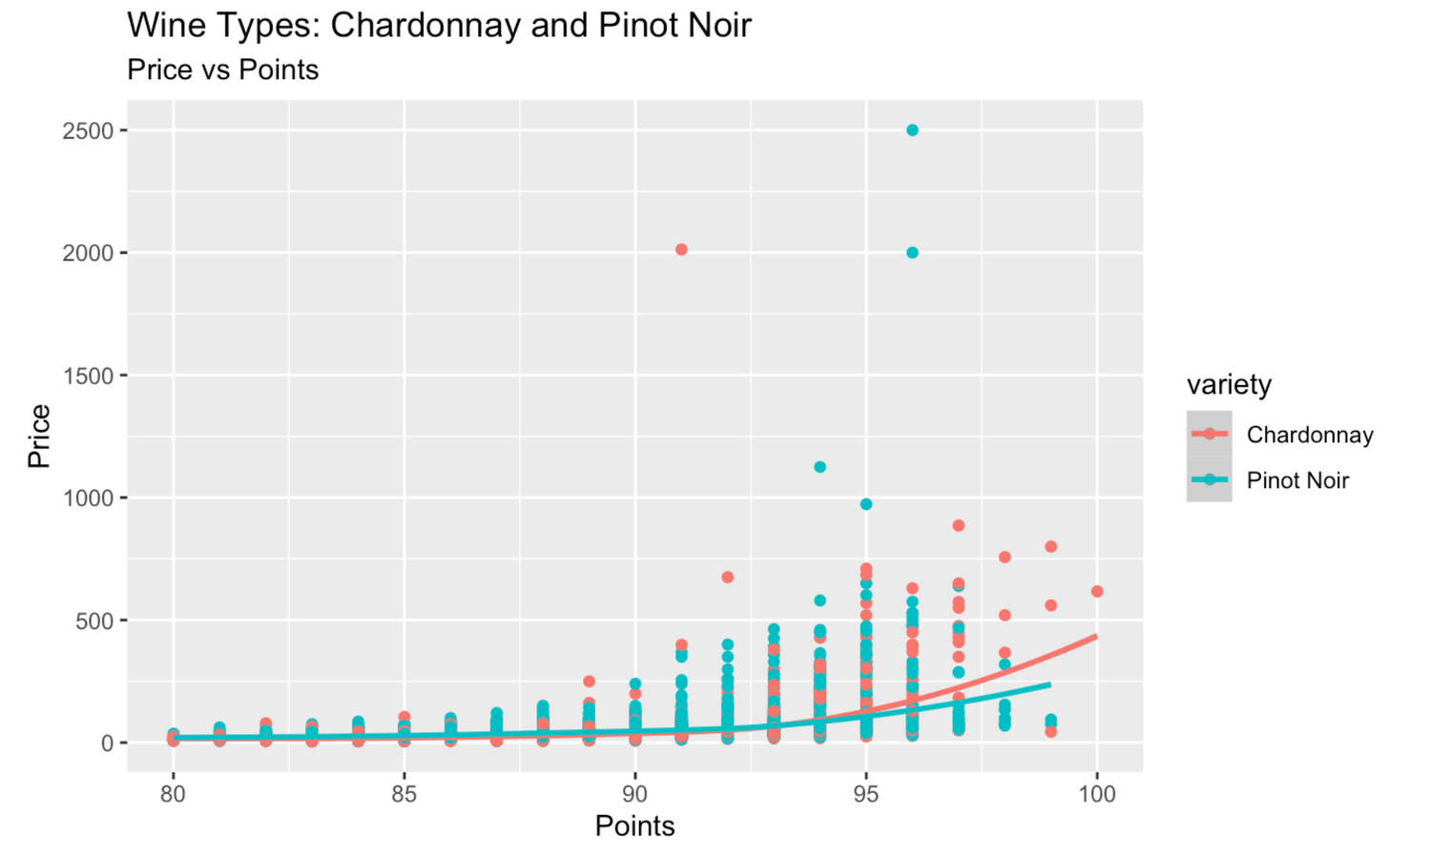

Slide 8
REGRESSION MODELS
Performed linear regression as well as nonlinear regression models.
Concluded that the best model for predicting price is nonlinear, as RMSE value was lower.

